Slide 1
PRIME PRIORITY MEDICINES
Liesbeth Hof
Managing & Senior Consultant
10 October 2017

Slide 2

Aim: to bring promising innovative medicines to patients faster by optimising and supporting medicine development.
Notes:
Bronnen: eigen ervaringen, EMA incl 1st year report, annual Topra mtng

Slide 3

Agenda
Introduction PRIME
requirements
benefits
application
Experiences
Challenges & considerations
timing
internally
externally

Slide 4
PRIME
Since March 2016
PRIME helps developers of promising new medicines to optimise development plans:
fostering early, coordinated and continuous dialogue with stakeholders to facilitate robust data collection and high quality marketing authorisation applications
speeding up evaluation so that medicines can reach patients earlier
encouraging developers to focus resources on medicines likely to make a real difference to patients’ lives.
Notes:
Speeding up evaluation – accelerated assessment, if not less Qs less time to respond

Slide 5
PRIME: requirements for application
Eligibility criteria:
Initial MA and Centralized Procedure
Demonstrate unmet medical need
Show potential to significantly address the unmet medical need
Provide supportive evidence, based on early clinical data.
Who can apply?
Non-SME/non-academia
from proof-of-concept stage (i.e., in principle prior to Phase III/confirmatory clinical studies), based on preliminary clinical evidence
SMEs and academia
from the proof-of-principle stage (i.e., prior to Phase II/exploratory clinical studies) on the basis of compelling non-clinical data and tolerability data from initial clinical trials

Slide 6

PRIME: potential benefits
Early appointment of Rapporteur from CHMP
CHMP meeting following PRIME designation
“Kick-off meeting" with:
the company
EMA
the Rapporteur
a multidisciplinary group of experts from relevant scientific committees and working parties
Assignment of a dedicated contact point at EMA
Confirm potential for accelerated assessment at time of MAA
Scientific advice at key development milestones, involving additional stakeholders such as HTA bodies
Notes:
No Rapporteur for SME, mainly at EMA level (ie also no kick-off mtng) – lead from Proof of principle to Proof of concept

Slide 7

Eligibility request submission
Submission package, templates available on EMA website:
pre-submission request form
applicant’s justification form (~30 pages)
Deadline Submission | Start of procedure (SAWP) | SAWP recommendation | CAT recommendation * | CHMP adoption | Rapporteur assignment
Day 0 | ~Day +5 | ~Day +35 | ~Day +42 | ~Day +50 | ~Day +80
* In case of advanced therapy medicinal products
Notes:
guidance and process around eligibility are considered clear and understandable – more insights to ensure probability of success needed

Slide 8
PRIME eligibility outcome published following CHMP meeting
Name
Name of the active substance, INN, common name, chemical name or company code. Name NOT mentioned if product is not eligible
Substance Type | Therapeutic Area | Therapeutic indication | Type of data supporting request | Type of applicant
Chemical Biological | E.g. oncology, cardio-vascular | E.g. treatment of sickle cell disease | Nonclinical Clinical exploratory Clinical confirmatory | SME applicants are micro-, small-and medium-sized-enterprises registered with the Agency’s SME office. Other types of applicants are those not qualifying or not registered as SME or not fulfilling the definition of academic sponsors

Slide 9
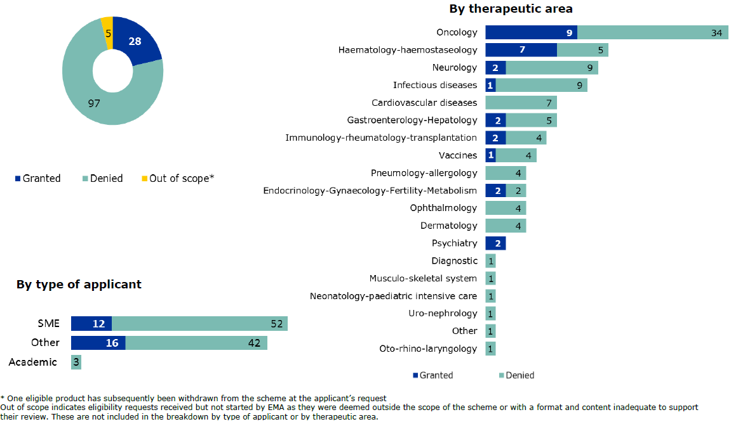
Cumulative overview of recommendations on PRIME eligibility requests (14Sep2017)
Notes:
Out of scope – not assessed by EMA

Slide 10

EMA reasons for denial of PRIME status
~80 % of PRIME applications denied PRIME status by EMA
EMA provided the following reasons:
failing to provide enough evidence to support claim of major therapeutic advantage over existing treatments
in late stages of development and for which the benefit of development support through PRIME was considered limited
too early in development (no clinical data; SME) or out of scope as only SMEs and academic sponsors can apply in early stages of development (non-SME)
unreliable data to substantiate PoC e.g. due to trial design issues, inconsistency in results
Notes:
- Possibility for a teleconference in case of rejection to provide more details and clarity around the reasons for rejection.
through a clinically meaningful improvement of efficacy, such as having an impact on the prevention, onset and duration of the condition, or improving the morbidity or mortality associated with the disease

Slide 11

Challenging timing
Narrow opportunity window between sufficient PoC data and too much regulatory advice already received, particularly for medicines with non-standard development plan
Experience: flexibility in the development stage of accepted medicines (up to Phase III) → depends on the added value PRIME can bring – e.g. multiple committees’ involvement, enrichment of product development
The CHMP rationale was clear however, at the time of 1st rejection the company followed advice from the decision letter and provided more data with the 2nd application, so it was a disappointment to get rejected because the product is too far advanced in development. The CHMP should be aware that oncology products (similar to rare diseases products) usually follow an accelerated development *
*Surveys of EU Trade Associations member companies in Apr ‘16 and May ‘17

Slide 12
What to consider when applying….. Internally
PRIME scheme can be resource intensive
global environment, similar schemes in other jurisdictions ongoing (US, Japan)
smaller companies
change in working internally due to advanced input on different aspects of the product development and life cycle
open to discuss also post-authorization plans e.g. post-marketing surveillance
still new and unproven – no insights regarding the criteria for selection or decision-making
Notes:
- Japan: Sakigake (2015), US: Breakthrough designation (2012), Prime (2016)
Breakthrough designation: quicker, less formal interactions take place

Slide 13
What to consider when applying… Externally
eligibility request template does not provide a section to highlight particular issues w/i the development plan to be discussed
major/key issues to be addressed as part of scientific advice (SA) requests, meetings can be organised with the Rapporteur and EMA on an ad hoc basis. Still option for national SA, as long as interactions are transparent
shorter SA process can be applied on a case by case basis, provided that this does not impair the quality of the advice.
co-rapporteur is appointed 6-7 months prior to the marketing authorisation application (MAA) submission
use of tools/schemes is not mutually exclusive
PRIME → compassionate use → accelerated assessment → conditional MA
Notes:
The Agency took note of the suggestion to include a subheading in the justification template for the applicant to highlight particular characteristics of the development that warrant further support through PRIME.
Shortening SA by shortening pre-submission timing or processes)

Slide 14
Multi-stakeholder input within EU jurisdiction
Industry
Patient Groups
HTA bodies
EMA
+
Scientific Committees
Incorporate patient perspective in clinical development
Alignment with regulator’s on requirements and pathway
Alignment with HTA-Bs and payers
Notes:
Envelope
not only impact on PRIME, but overall awareness of earlier interaction and adjustment of organisations towards early stakeholder input

Slide 15
Thanks for your attention!

Slide 16
EMA procedures in a nutshell…
 | Adaptive Pathway | PRIME
Eligibility requirements | High medical need Collection of data difficult via traditional routes Iterative development plan Use of real-world data to supplement clinical trials | Unmet medical need Promising new medicine that fulfils criteria for accelerated assessment Supportive evidence from early clinical data Show potential to address need
Advantages | Early multi-stakeholder dialogue Feedback on suitability of planned data collection with real-world data Multidisciplinary expertise from regulators, HTA, patients Potential involvement of payers on an ad-hoc basis | Early proactive support Enhanced interaction and early dialogue Possible accelerated assessment Multidisciplinary expertise from regulators, possibility to involve patients and HTAs

Slide 17
Adaptive Pathway: conditions
No fee required, only with submission of SA HTA request
Adaptive pathway is based on three principles:
Iterative development
staggered approval or
B/R confirmation of Conditional Marketing Authorisation
Real-world data supplements clinical trial data
Patients and HTA bodies involved in product development program discussion

Slide 18
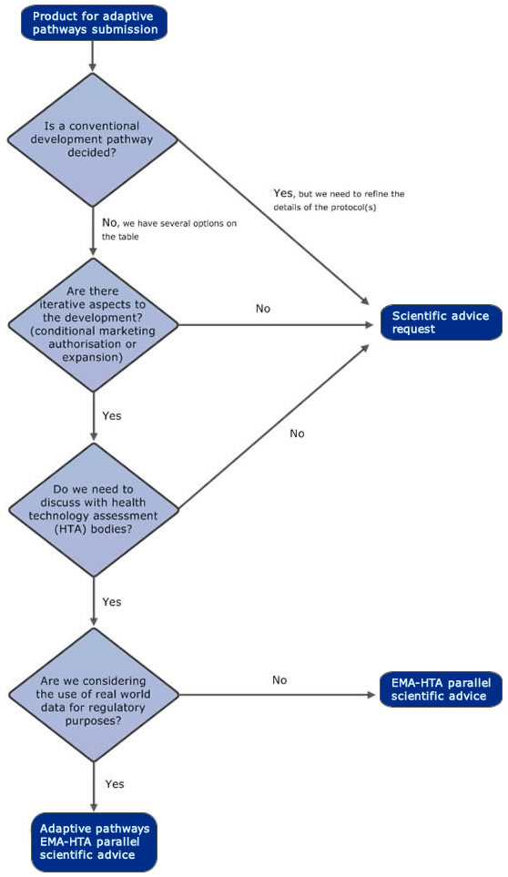

Slide 19
Exceptional Circumstances
Applicant is unable to provide comprehensive data
Indication so rare that no large phase III trial can be performed
Present state of scientific knowledge prohibits provision of comprehensive information
Ethical concerns
MA also subject to specific obligations
Annual reassessment of risk-benefit
Particular emphasis on safety of product
Formal application to be submitted before MAA

Slide 20
Conditional approval
Extensive studies/data may not be required in case of:
Seriously debilitating/ life-threatening diseases
Emergency products for Public Health threats
Orphans
Requirements:
Positive benefit/risk balance
Unmet medical need
Possibility to provide comprehensive data
Benefit to public health outweighs the risks of placing on market without comprehensive studies
Prerequisite: MA subject to specific obligations (to provide comprehensive data)

Slide 21
EMA evaluation of adaptive pathway pilot
~90% of adaptive pathway applications denied adaptive pathway status by EMA (total of 62, only 6 eligible)
Pilot project March 2014 – August 2016. Learning points:
Patients need to be increasingly involved in selection
Clear definition needed of methodologically-sound strategies of real-world evidence to support
Efficacy
Safety
Reimbursement
Key elements of adaptive pathways concept:
Systematic safety monitoring

Slide 22
Accelerated assessment
Pre-submission meeting 6-7 months before submission to prepare for evaluation
Discuss proposal with CHMP, PRAC, CAT if ATMP
Justify major public health interest + therapeutic innovation
150 days instead of 210 days, 3 rounds
90 days assessment → 1 month clockstop → 30 days assessment → no clockstop → 30 days assessment → outcome
For ATMPs: 2 rounds 120+30 days of assessment
Advantage: much quicker
Disadvantage: much less time for response to questions
All relevant departments need to be available
If at day 120 or 150 CHMP or applicant consider accelerated assessment no longer appropriate, assessment may continue under standard timelines

