Slide 1
Commission Implementing Regulation (EU) 2025/1466 of 22 Jul 2025
Auditing from an MAH Perspective
PPN-NVFG Nederlandse Vereniging voor Farmeceutische Geneeskunde
Deepti Naik, Associate Director PVQA, Astellas
19 May 2026

Slide 2
Agenda
Background
Who is impacted ?
What has changed for QA ?
What does not change for QA ?
What is the challenge for QA ?
Identifying Potential Solutions
Let's Discuss

Slide 3
Disclaimer
Disclaimer: The speaker is a paid employee of Astellas. This presentation is intended for informational purposes only and does not replace independent professional judgment. This presentation is not intended to provide medical or legal advice. Statements of fact, positions taken and opinions expressed are those of the speaker individually and, unless expressly stated to the contrary, do not necessarily reflect the opinion or position of the speaker’s employer, Astellas, or any of its subsidiaries and/or related entities.

Slide 4
Background
Commission implementing regulation (EU) 2025/1466 of 22 Jul 2025 came into force on 12 Aug 2025
Article 1, points (7) and (9) apply from its entry into force
Applies from 12 Feb 2026
Main Points
QPPV Oversight
PSMF
Signal Detection
Periodic Safety Update Report (PSUR)
PASS Transparency
ICSRs
Third Party and Vendor Oversight
Risk Based Audits
Impacts the QA Function

Slide 5
Who is Impacted ?
Marketing Authorisation Holder(s) (MAH)
Responsible for the PV system and adherence to the regulations
Pharmacovigilance Dept.
Primary stakeholder
Quality Assurance
Regulatory Compliance, risk assessments, audits
Others
Medical Affairs, Medical Information, Commercial, Regulatory Affairs, Legal, Procurement etc.
Vendor(s)
Execution of contracted tasks
Regulators
Regulatory guidance, MAH and subcontractor inspections
Audit Perspective

Slide 6
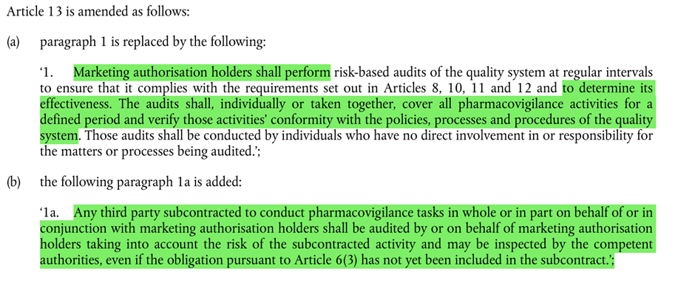

What has Changed for QA ?
Article 13 of Commission Implementing Regulation of 520/2012
Effectiveness of Quality System
Requirements
Cover ALL PV activities
Explicit requirement to Audit all subcontractors conducting “PV” tasks
Inspection of PV subcontractors by Regulators

Slide 7
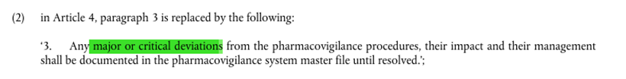
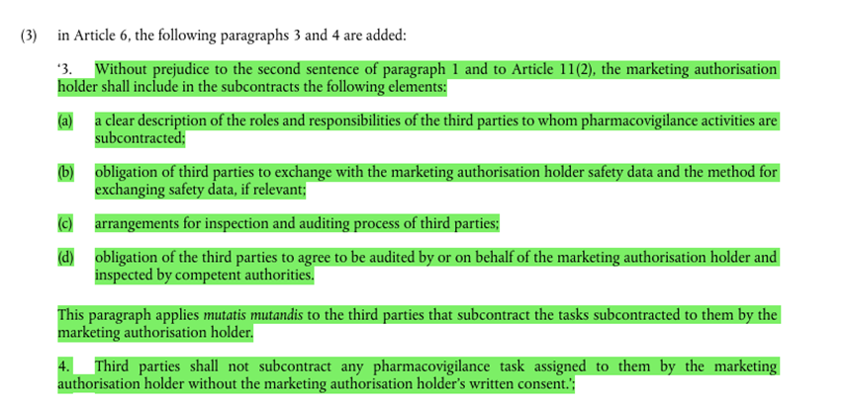

What has Changed for QA ?
Other related considerations
Deviations from Vendors impacting MAHs PV system
Update Contracts and/or contract template updates

Slide 8
What does not Change for QA ?
Requirements stated in 520/2012 and GVP Modules
Requirement to audit and its objective: Perform regular risk-based audit(s) of the PV System to evaluate its appropriateness and effectiveness
Comprehensive Audit Universe: All PV processes, Quality Management System, Interactions with other departments. All entities including affiliates, business partners, vendors involved in PV tasks.
Risk Assessments: Focus on areas of highest risk to the organisation(s) PV system including its Quality system.
  Strategic Level Planning : Long term audit strategy (2-5 years). Auditing Approach for the entire PV system.
  Tactical Level audit Planning: Annual audit schedule includes list of audits to be conducted including a brief description of the plan for each audit to be delivered, including an outline of scope and objectives.
  Operational Level Audit Planning: Individual audit engagements including individual audit planning, conduct reporting and follow up.

Slide 9
What does not Change for QA ?
Operational Level Audit Planning (continued)
Audit Planning : Audit scope, audit criteria, sampling strategies, audit sample, audit limitations determined using a audit methodology.
  Audit Conduct: Data gathering, thorough review, assessment and meticulous audit execution to identify non-compliance with regulations, procedures and/or contractual obligations.
  Audit Reporting: Consistent drafting of audit reports. Audit reports distributed to the management responsible for the area audited and/or staff to whom tasks are delegated.
  Follow up: Corrective and Preventive actions should be implemented.Follow-up audit should be conducted, as required. Procedures and methods should be in place to verify effectiveness of actions taken.

Slide 10
What does not Change for QA ?
Independent, Qualified and Experienced Audit Team: Independent, objective, qualified audit team who are proficient in knowledge, skills and abilities to conduct GVP audits.
Involvement of the EU QPPV: Provide information to auditors relevant for risk assessment, trigger an audit as required, informed of scheduled audits, notified of audit results and correction and preventive action plan for each audit.

Slide 11

What is the Challenge for QA ?
PV Universe

Slide 12
Identifying Potential Solutions
Vendor audits in association
with affiliates or process/system audits
(end to end process)
Compliance & Training
Manage Time
Resources
Budget
Practical
Critical Thinking
Simplify Processes
Abbreviate Risk Ranking processes
e.g., Low risk vendors
Simplify audit documentation
e.g., one audit plan
Use of external auditors
Carefully determine the PV vendor audit universe e.g., PV vs Non-PV
Cross training of GxP auditors
Robust vendor selection
and Qualification Audit(s)
Full-scale vendor audits for key/high risk vendors (non-negotiable)
Vigorous vendor oversight (operational)
Remote Audits vs Onsite audits
Mini-audits: Use of questionnaires or
surveys with agenda, document review
and interviews for low-risk vendors
Training on the Regulation and/or associated procedures

Slide 13
Ensuring compliance from an Auditing Perspective
Awaited regulatory guidance (GVP Module updates)
Inspection Intelligence
Industry Benchmarking
Information Sharing

Slide 14
THANK YOU

Slide 15
Ensuring Compliance from an Auditing Perspective
Regulatory Intelligence Process
Regulation Impact Assessment and updates to procedural documents
Training on the regulation and/or procedural updates
Adherence to the regulation and procedural documents
Examples:
  Contracts – Updates to contracts with audit, inspection, subcontracting, CAPA clauses
  PSMF – Revised deviation requirements, vendor CAPAs impacting MAH PV system
  Signal Detection – Updates process to include EudraVigilance monitoring into routine process, align with PRAC–led signal assessments
  Periodic Safety Update Report (PSUR) – Revision to PSUR templates to include implementation of risk-minimization measures
  Vendor audits - Increased focus on vendor oversight and subcontracted activities by the vendor

