Slide 1

Perspectief op kwaliteit, toegang en integratie van data in de farmacovigilantie
Theo Bothoflezing - PPN Voorjaarsbijeenkomst 19 mei 2026
Prof. dr. Florence van Hunsel
Netherlands Pharmacovigilance Centre Lareb &
Faculty of Science and Engineering at Groningen Research Institute of Pharmacy
Prof. dr. Florence van Hunsel, Netherlands Pharmacovigilance Centre Lareb &
Faculty of Science and Engineering at Groningen Research Institute of Pharmacy

Slide 2
Conflicts of Interest
None to declare

Slide 3
Finding safety signals
New, unlabelled adverse event
Labelled events with increased frequency,severity specificity
Interactions (Drugs, Food, Alcohol, Herbals)
Product issue or Medication issue
Identification of new population at risk
New beneficial effect
A safety signal is information on a new or known adverse event that may be caused by a medicine and requires further investigation
Safety signals can be detected from a wide range of sources

Slide 4
Generation of knowledge in PV
Riskgroups
Re-occurence
Effects on pregnancy & lactation
Interactions with drugs, food, herbals
Medication errors
Patient experiences
Unknown ADRs
Batch issues

Slide 5
Combination of datasources needed in PV
Signal
Clinical trial data
Real World Data
Animal studies
Spontaneous Reporting Systems
Literature
Signal detection
First suspicion of Drug_ADR association
Signal Strengthening
Strength of association in cases, disproportionality, trends, data from other sources
Signal evaluation
Confirmation, quantification, risk groups, further information

Slide 6
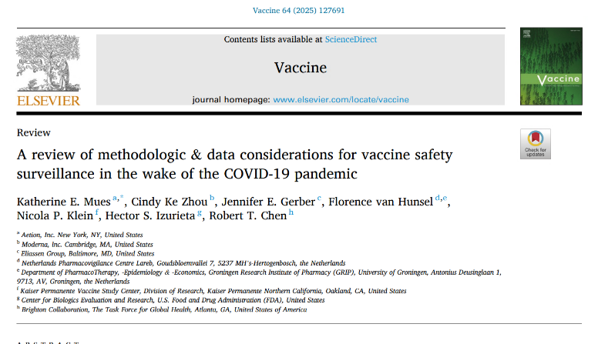
Combination of datasources needed in PV
Signal
Clinical trial data
Real World Data
Animal studies
Spontaneous Reporting Systems
Literature
Signal detection
First suspicion of Drug_ADR association
Signal Strengthening
Strength of association in cases, disproportionality, trends, data from other sources
Signal evaluation
Confirmation, quantification, risk groups, further information

Slide 7
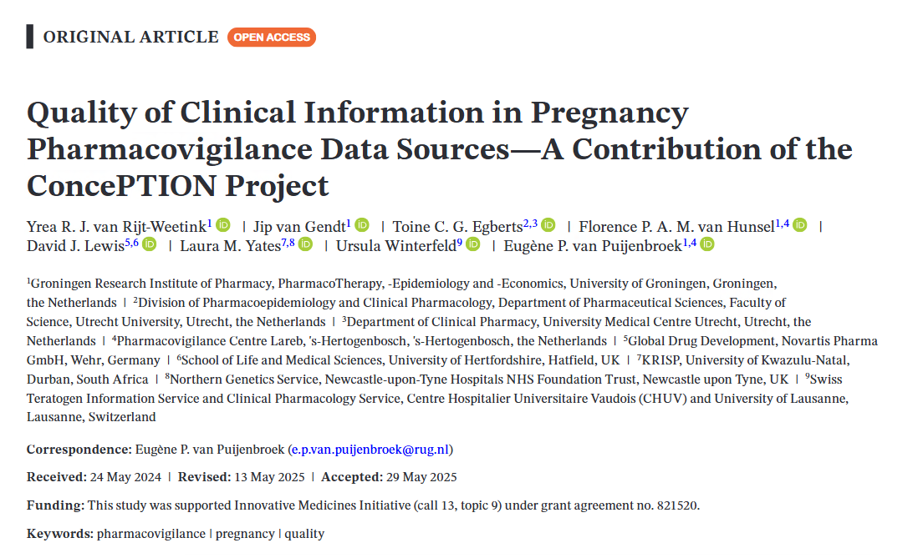
Combination of datasources needed in PV
Signal
Clinical trial data
Real World Data
Animal studies
Spontaneous Reporting Systems
Literature
Signal detection
First suspicion of Drug_ADR association
Signal Strengthening
Strength of association in cases, disproportionality, trends, data from other sources
Signal evaluation
Confirmation, quantification, risk groups, further information
Notes:
Purpose: Good documentation of adverse events related to medicines is essential for the assessment of safety signals. Informationon the clinical quality of primary pregnancy safety data sources is lacking. The objective of this study was to assess the differ-ences in clinical quality of various sources of primary pregnancy pharmacovigilance (PV) data.Methods: Fifty reports of exposures to medicines during pregnancy were collected from: spontaneous and literature reportsfrom EudraVigilance, European Network of Teratology Information Services (ENTIS), the Dutch Pregnancy Drug Register, en-hanced PV programmes (EPV), and patient support programmes (PSP). Reports were standardized and anonymized, after whichtheir clinical quality was assessed. Mean scores per source were compared using ANOVA (analysis of variance test).Results: Mean clinical quality scores were 89.0% (SD 10.1%) for the Dutch Pregnancy Drug Register, 77.1% (SD 13.3%) for TIS,64.7% (SD 20.5%) for EPVs, 49.5% (SD 16.2%) for PSPs, 40.9% (SD 21.6%) for spontaneous reports, and 38.6% (SD 18.0%) for lit-erature reports. All were statistically significantly different (p ≤ 0.05) except for spontaneous versus literature reports (meandifference 2.2%, p = 0.99) and spontaneous reports versus reports from PSPs (−8.6%, p = 0.14).Conclusions: For data sources specifically designed for pregnancy data collection, the clinical quality of information generallyoutweighed sources designed to capture general safety information. EPV methods showed better scores for clinical quality com-pared to spontaneous reporting data for pregnancy PV.

Slide 8

Signal Management process at Lareb
Data analysis
Knowlegde dissimination
Knowledge generation
Data processing
Data collection
Datasources: SRS, Cohort Event Monitoring, Dutch Pregnancy Drug Register (DPDR), Literature, Hospital Electronic Health Records (EHRs)
Includes: Case intake + checks, Coding, Automatic handing for some cases, Triage, Causality assessment, follow-up, quality checks, automatic export to EMA
Includes: Case-by-Case analysis, screening tools (AE screening, batch analysis for vaccines, Observed vs Expected, literature screening), predictive modelling for cohorts, bespoke methods (clustering, structural topic modelling) + additional cases finding in EHRs + Signal Detection meetings
Includes: writing of signal documents, publications, reports and online knowledge pages
Includes: all further communications, including the online kowledge bank on the Lareb website

Slide 9
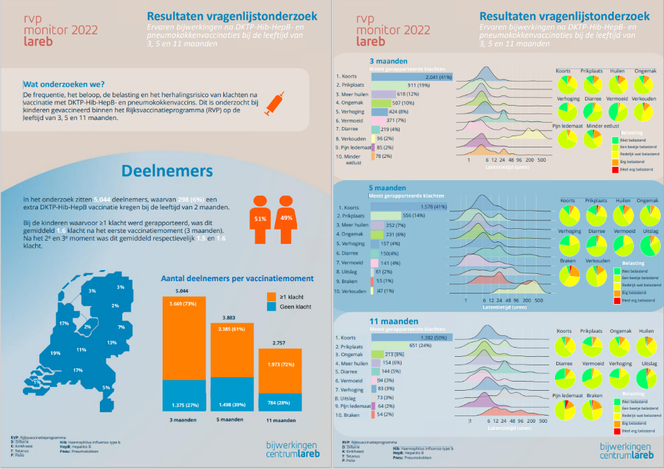

Slide 10
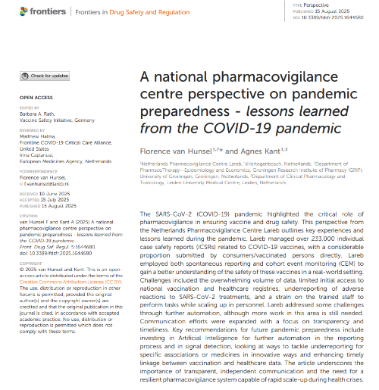
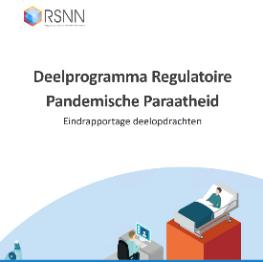
Needs identified during COVID-19 pandemic
Huge volume of cases > 250,000 ICSRs of vaccines, but only 250 ICSRs on drugs
Lack of data in certain areas
Using hospital EHR for signal strengthening
Data-infrastructure → better linkages between data sources
https://www.zonmw.nl/sites/zonmw/files/2024-03/Finaal-Eindrapport-Deelprogramma-Regulatoire-Pandemische-Paraatheid-240311.pdf

Slide 11

International Working Group on New Developments in Pharmacovigilance
Established in 2019 and coordinated by DSRU
>65 global experts in pharmacovigilance and pharmacoepidemiology
Aim to advance existing methodologies used in the detection, monitoring, and analysis of safety data in pharmacovigilance and to communicate best practice proposals to support decision making in health care
Notes:
Firstly, I wanted to introduce the International Working Group on New Developments in PV, under which this work was completed. The group was established in 2019 and is coordinated by the DSRU.
It contains more than 65 global pharmacovigilance and pharmacoepidemiology experts.
And the aim of the group is to advance existing methodologies used in the detection, monitoring, and analysis of safety data in pharmacovigilance and to communicate best practice proposals to support decision making in health care.

Slide 12
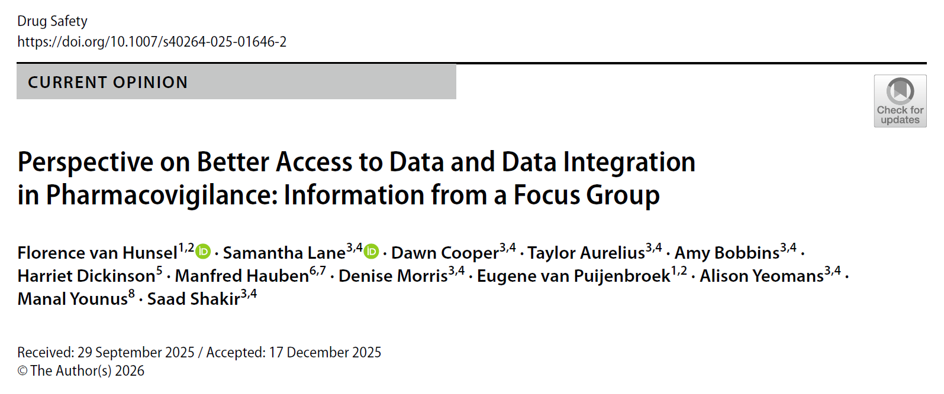
Notes:
As part of the International Working Group, we have been conducting research into two areas, causality assessment and data sources in pharmacovigilance. Today we are continuing the discussion around our recently published paper titled Perspective on better access to data and data integration in pharmacovigilance: Information from a focus group.
We conducted this work because the number of data sources available for pharmacovigilance is increasing, and making decisions on the most appropriate source is becoming increasingly difficult.
Each type of data source comes with its own challenges, and bringing information together from disparate sources of data is challenging. We therefore wanted to understand the practical challenges faced when accessing and integrating data for pharmacovigilance, and how we might approach the integration of diverse data in future.
I’ll share some details on the research, which consisted of a focus group of international PV experts exploring how improved data access and integration can strengthen signal detection and drug safety.

Slide 13
Focus group overview
Real-world data are the data relating to areas such as patient health status and/or healthcare delivery not collected in conventional randomised controlled trials. (ISPOR, 2026)
Nine international PV experts
Academia
Industry
Regulators
Goal:
To identify integration challenges and practical solutions for real-world data used in PV
Notes:
The focus group consisted of nine experts with diverse PV experience to identify the main obstacles to integrating real-world data in pharmacovigilance, and discuss practical solutions to make pharmacovigilance more efficient and robust.
The participants represented academia, industry, and regulatory agencies, and most had 11-20 years experience in pharmacovigilance. 78% were male. We had representation from Europe, Eastern Mediterranean, and North American regions.

Slide 14
Current data landscape in PV
Clinical trials – high quality, limited generalisability
Real-world data – electronic health records, registries, claims, social media
Spontaneous reports – EudraVigilance, FAERS, VigiBase
Strengths vs Limitations of each source
Notes:
Participants emphasized that while multiple sources of data exist for use in pharmacovigilance, from trials to spontaneous reports, each comes with unique limitations. The challenge is how to leverage their strengths collectively for more robust signal detection.

Slide 15
Integration challenges
Data heterogeneity & lack of interoperability
Quality variability & missing data
Regulatory, privacy, and ethical constraints
Unequal access for low-resource settings
Notes:
That brings us onto the topic of data integration.
It was concluded that data integration in pharmacovigilance must go beyond aggregation of data, rather triangulation across the diverse range of sources is essential.
However, integration remains constrained by technical issues, inconsistent data quality, privacy concerns, and unequal access, which can slow cross-regional or cross-sector PV analyses.

Slide 16

Emerging opportunities
Knowledge graphs and Artificial Intelligence
  Connecting drugs, ADRs, patient characteristics…
Secure, ethical data-sharing (Federated learning)
Collaborative frameworks such as VAC4EU
Notes:
The experts in the focus group highlighted innovative approaches, particularly knowledge graphs and AI, which can unify diverse datasets to uncover complex relationships. Secure collaborative platforms and triangulating multiple sources through collaborative frameworks can further enhance PV analytics.

Slide 17
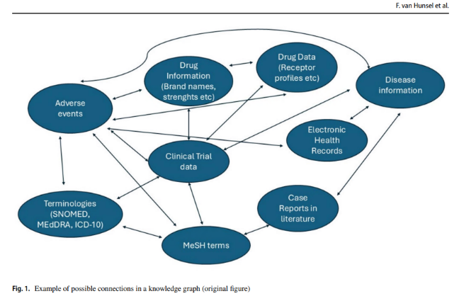
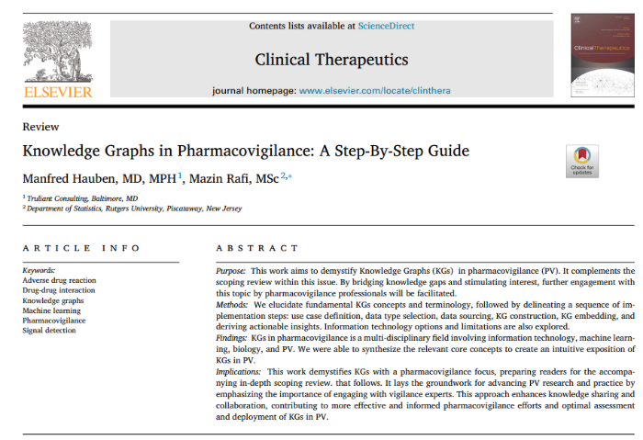

Slide 18
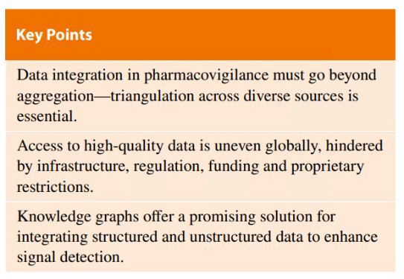
Key takeaways for PV practice
Access + integration = faster, more robust signal detection
Enhances cross-sector and cross-region collaboration
Moves PV towards data-rich, transparent, dynamic monitoring
Notes:
The consensus from the focus group was clear: better data access and integration directly translates into faster, more robust detection of safety signals, and helps bridge regional and institutional disparities.
By enhancing integration, data access, and methodological rigour, we can strengthen pharmacovigilance processes and enhance global drug safety monitoring.

Slide 19

How can we improve the quality and/or integration of our data?
Follow-up of ICSRs
Signal strenghtening by searching EHRs for additional cases

Slide 20
How can we improve the quality and/or integration of our data?
Follow-up of ICSRs
Signal strenghtening by searching EHRs for additional cases

Slide 21
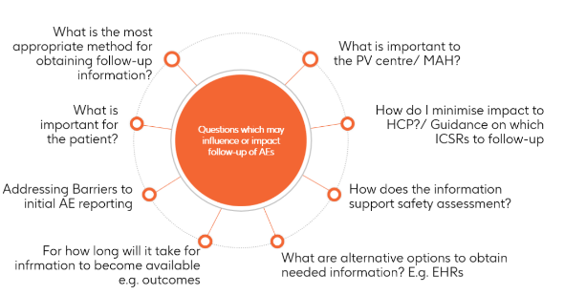
Baselining Follow-up in Pharmacovigilance
Results of a scoping review
The first comprehensive review of literature and regulations to provide a baseline for follow-up practices in PV¹
  - Review of 746 abstracts
  - Review of 41 Regulations and Guidance’s
No consistency in use of term “follow-up”
Supports risk-based approach to follow-up, based differing performance across study types and methods used
Positioning for data-driven solutions which aim to address future research areas²
1 Kara V, Van Hunsel F, Bate A, van Puijenbroek E. The Role of Adverse Event Follow-Up in Advancing the Knowledge of Medicines and Vaccines Safety: A Scoping Review. Drug Saf. 2025 Sep;48(9):977-991
2 Kara V, Powell G, Ramcharran D, Bate A. Risk-Based Stratification of Pharmacovigilance Data for a Differentiated Approach to Follow-Up; Abstract accepted for ISPE Washington 2025

Slide 22
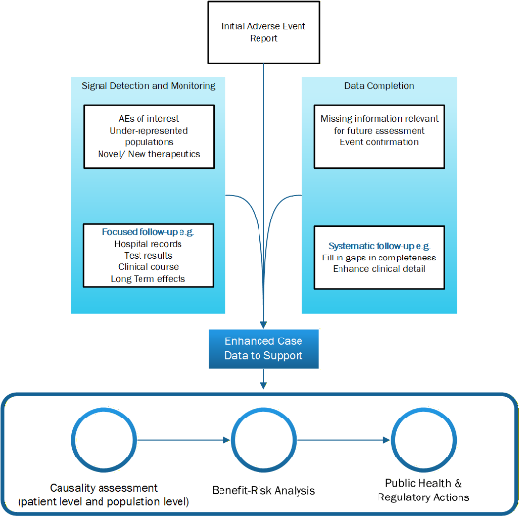
Improving Medicines and Vaccines Safety: Expert Perspectives on AE follow-up
Context and challenge
Initial Adverse Event (AE) reports are often incomplete
Follow-up obtains more data but is resource intensive for PV Organisations and reporters
Need to prioritise value
Study Method
Delphi Method: to build expert consensus
10 Global Experts interviewed
Data saturation reached
Enablers and Considerations
Use of AI for triage and identification of relevant information for follow-up
Automated/ structured reporting tools
Burden on reporters (HCP/ Patients)
Conclusion
PV follow-up is context dependent, supporting a shift to proportionate, purpose-driven follow-up strategies for consistent and efficient use of resources including criteria for prioritization and de-prioritization.
guided by a structured, proportionate, and purpose-driven approach
1 Kara V, Van Hunsel F, Younus Y, Hauben M, Bate A, van Puijenbroek E. When does Follow-Up on Adverse Events Improve the Understanding of Medicine and Vaccine Safety? Insights from Global Expert Perspectives . Under review

Slide 23
How can we improve the quality and/or integration of our data?
Follow-up of ICSRs
Signal strenghtening by searching EHRs for additional cases

Slide 24
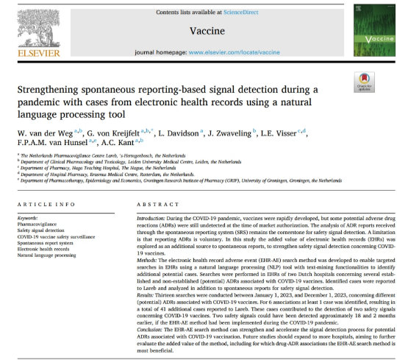
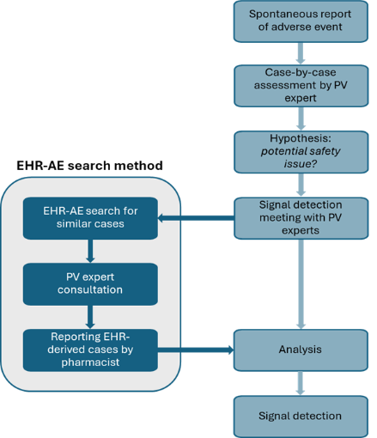
Targeted searches in Hospital Electronic Health Records with a text-mining data collector tool (CTcue)
Currently: ZonMW implementation project
Notes:
The EHR-AE search method uses a text-mining data collector tool (CTcue, IQVIA Solutions BV) to construct search queries using structured (e.g. laboratory findings, medication requests, diagnostic procedures) and unstructured (e.g. clinical notes, hospital letters) EHR data. In CTcue, snippets of EHRs that meet the search criteria are analyzed to find potential cases of a specific drug-ADR association. For the potential cases, the full EHRs of the patients are consulted to verify whether the case is a potential ADR, and is of added value to signal detection. Cases that meet these criteria are reported to Lareb and included in the spontaneous reporting system as reports from study.

Slide 25
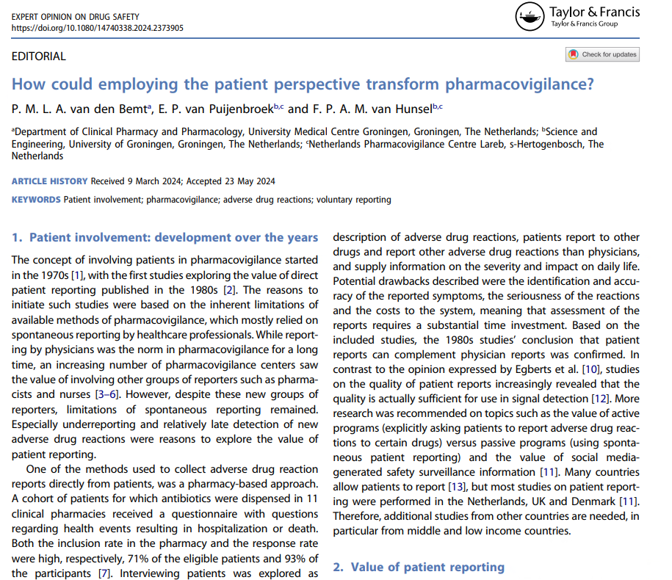
Future scenario of patient involvement: the new hospital and beyond

Slide 26
Thank you
for your attention!

