Slide 1



Ontwikkelingen in CTR-onderzoek in Nederland en Europa
Jan Willem Kleinovink
Special advisor, CCMO ctr@ccmo.nl
NVFG ClinOpsDag 14-04-2026

Slide 2

Ontwikkelingen in CTR-onderzoek in Nederland en Europa
Biotech Act – de weg richting implementatie
Toetsing CTR-onderzoek in Nederland
Europese samenwerking en ontwikkelingen
Informatiebronnen en troubleshooting
Discussie

Slide 3
Vragen en stellingen
Wat is er nodig om Nederland aantrekkelijk te houden/maken voor commercieel klinisch onderzoek?
En wat voor academisch (investigator-initiated) onderzoek?
Zien jullie de afgelopen 2 jaar trends in
  het aantal studies met conditionele goedkeuring, leidend tot vertraging studiestart?
  verschillen tussen METCs, en tussen lidstaten, in de beoordeling?
Bij vragen of problemen mbt CTR/CTIS weet ik waar ik moet zijn.
De lidstaten (bevoegde instanties) zijn goed bereikbaar voor vragen.

Slide 4
Biotech Act

Slide 5
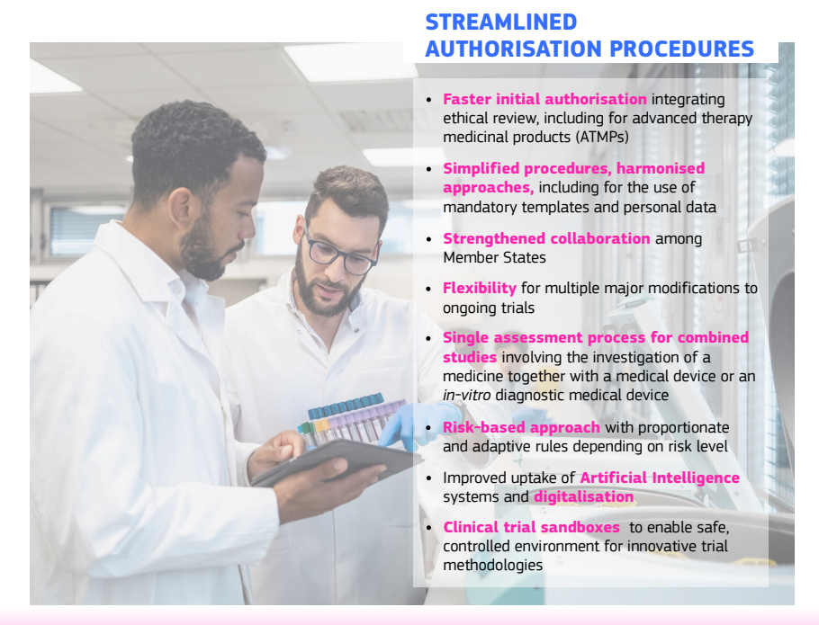
Biotech Act (BTA)
FACTSHEET BIOTECH ACT – 16-12-2025
Changes to the application / assessment process:
RMS shall involve Ethics Committee in part I review
Limited grounds for considerations + opt-out
SM: shorter timelines, parallel submissions
Core IMP dossier: IMPD and IB

Slide 6
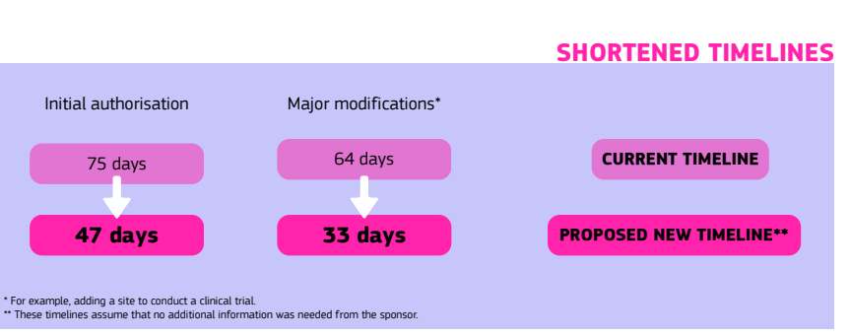
Shorter assessment timelines
Timelines in case of no RFI
Timelines in case of RFI
Initial
SM
Current
106 days
95 days
ATMPs: option removed to extend Part I timeline by 50 days
BTA
75 days
47 days

Slide 7
Initial application timeline under the Biotech Act
Multinational clinical trials
d0: RMS selected within 3 days (fair RMS workshare)
Validation phase and assessment phase in parallel
Validation RFI on d7, conclusion on d21 (for SM: d4, d14)
d28: RMS shares DAR after 28 days (or 21 days for SM, d21)
d35: MSC considerations after 7 days (or 3 days for SM, d24)
d42: RMS consolidation + RFI after 7 days (or 4 days for SM, d28)
d56: Sponsor RFI response after 14 days (or 7 days for SM, d35)
d63: MSC review RFI Response after 7 days (or 3 days for SM, d38)
d70: RMS enters Part I conclusion after 7 days (or 4 days for SM, d42)
d75: national decision
Ethics Committee meeting?
7-day rhythm → avoids weekend deadlines and timeline extensions → predictability

Slide 8

Europees wetgevingsproces
Wetsvoorstel Europese Commissie
NL Standpunt
Raadswerkgroepen
Europees Parlement
Visie / Amendementen
Formaliteit Standpunt Raad van ministers
(EPSCO)
Standpunt ambassadeurs
(COREPER)
Raad, Parlement en Commissie
+ Standpunten 26 andere lidstaten
Wet

Slide 9

Implementatie Europese wetgeving
Aangenomen Europese wetgeving
Europees verband
Nationale wetgeving
Verdere uitwerking van open bepalingen uit de EU wetgeving
Uitwerken van Implementing acts, Delegated acts en guidances
Richtlijn moet worden geïmplementeerd in nationale wetgeving
Verordening gaat in op beschreven datum in alle lidstaten tegelijkertijd
Nalopen nationale wetgeving op tegenstrijdigheden en verwijzingen
Notes:
Aanstippen verschil verordening en richtlijn. Verdere uitwerking van EU wetgeving moet nog plaatsvinden. Nationaal zorgt de verordening voor aanpassingen (bijv gnw/aanpalende wetgeving). De richtlijn moet nationaal ingericht worden.

Slide 10

Applying BTA timelines in the meantime
FAST-EU
Started Feb 2026
EU4Health
Joint Action
November ‘26
Biotech Act
2028?
FAST-EU (Facilitating and Accelerating Strategic Trials): limited pilot with BTA timeline
Initiative by HMA, CTCG and MedEthicsEU
2-3 trials per month – only multinational trials
Almost all MS participate in the project (NCA + Ethics)
  NL: CCMO and currently 2 MRECs, more MRECs expected to join soon
Prioritisation by impact; criteria include unmet medical need, number of MSCs, indication
Monthly slot to submit expression of interest
FAST-EU Sponsor Guide: CTCG website

Slide 11
Applying BTA timelines in the meantime
FAST-EU
Started Feb 2026
EU4Health
Joint Action
November ‘26
Biotech Act
2028?
EU4Health Joint Action: implementation of the Clinical Trials Regulation
EU funding to offer the BTA timeline on a larger scale, and to prepare for BTA implementation
Expected to start November 2026, replaces FAST-EU
NL: CCMO and all MRECs
Goals include:
  EU-wide harmonisation of assessment (process), both NCA and Ethics Committees
  Training and knowledge sharing for assessors → BTA: stronger role of RMS
  Aligning (Part II) templates → BTA: EU-harmonised templates mandatory

Slide 12
Toetsing CTR-onderzoek in Nederland

Slide 13
Rolverdeling CCMO en METCs
CCMO-bureau:
Ontvangt en valideert alle indieningen
  Toewijzing aan METC: op basis van voorstel uit cover letter, capaciteit en bevoegdheid
  Keuze over RMS-rol in overleg met METC
Ondersteunt METCs bij multinationale studies met Nederland als RMS (inhoudelijk en procedureel)
Ondersteunt CCMO-commissie bij CCMO-studies
Afstemming met autoriteiten van andere lidstaten
METCs:
Beoordelen indieningen voor METC-studies (beoordeling Part I + Part II en besluit)
Besluiten autonoom over goedkeuring van door hen getoetste studies
Preklinisch beoordelaar
Quality- beoordelaar
Klinisch beoordelaar en coördinator
Juristen
Bureau
Safety
Validatie
Europa
Planning

Slide 14

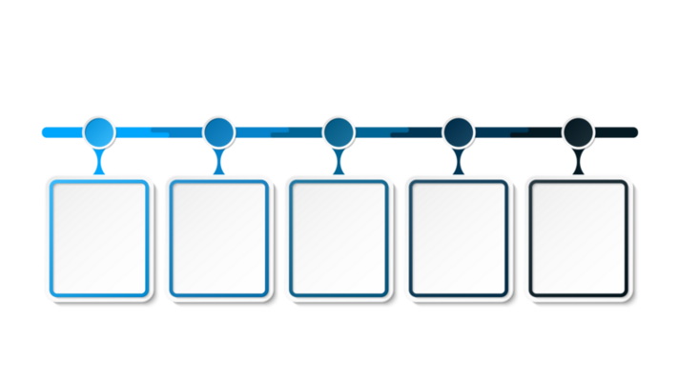

Toekomstbestendig toetsingssysteem
Check van de Europese Commissie 2021
Evaluatie van de WMO en CCMO 2023
Strategisch businessplan (CCMO en NVMETC) 2024
Reactie VWS op aanbevelingen 2024
Besluit over start programma 2025
Start van het programma sept 2025
Kabinet ziet Noodzaak voor herziening van toetsingssysteem
Voor beschikbaarheid;
Voor veiligheid;
Voldoen aan EU-wetgeving;
Goed systeem nodig voor stimulering klinisch onderzoek

Slide 15
Toekomstbestendig toetsingssysteem
Advies van CCMO en NVMETC:
vorm één organisatie waarin CCMO en alle METCs opgaan
Rapport en advies ‘bestuurlijk aanjager’ VWS verwacht in juni 2026

Slide 16
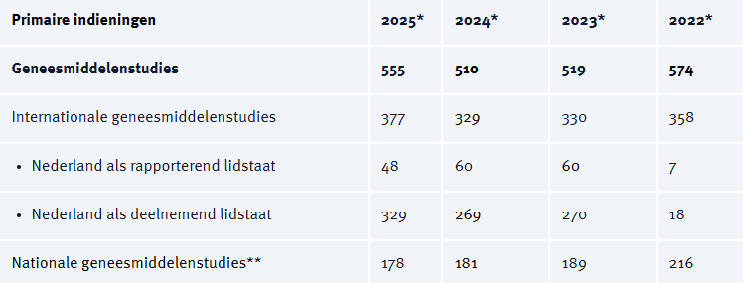
CTR-studies in Nederland
Inclusief AM voor NL. Negatief besluit bij <1%
Substantial modifications 2125
Non-substantial modifications (art 81.9) 1089
Jaarverslag CCMO 2025
NSM-indieningstype in CTIS is alléén voor wijzigingen die vallen onder artikel 81.9! (dwz direct rapporteren is noodzakelijk voor toezicht door autoriteiten)
Alle overige niet-substantiële wijzigingen pas indienen in CTIS bij eerstvolgende SM op hetzelfde ‘Part’
– geen probleem als er geen SM meer komt voor einde studie.

Slide 17
Europese samenwerking en ontwikkelingen

Slide 18


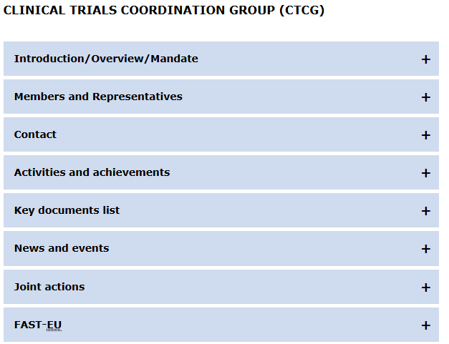
CTCG: European coordination of Part I (NCAs)
Clinical Trials Coordination Group
HMA working group, experts from national competent authorities (NL: Monique Al, vice-chair)
Harmonisation and coordination to support the full implementation of the CTR
Monthly plenary meeting
Weekly ‘assessors round table’ meetings → discuss trials, considerations, procedures, risk-based assessment
For assessors: Best Practice documents, knowledge sharing documents
For sponsors: guidance and templates
CTCG website
Cover letter templates
FAQ
Standard coding + naming of documents
Guidance on various topics/procedures
https://www.hma.eu/about-hma/working-groups/clinical-trials-coordination-group.html

Slide 19


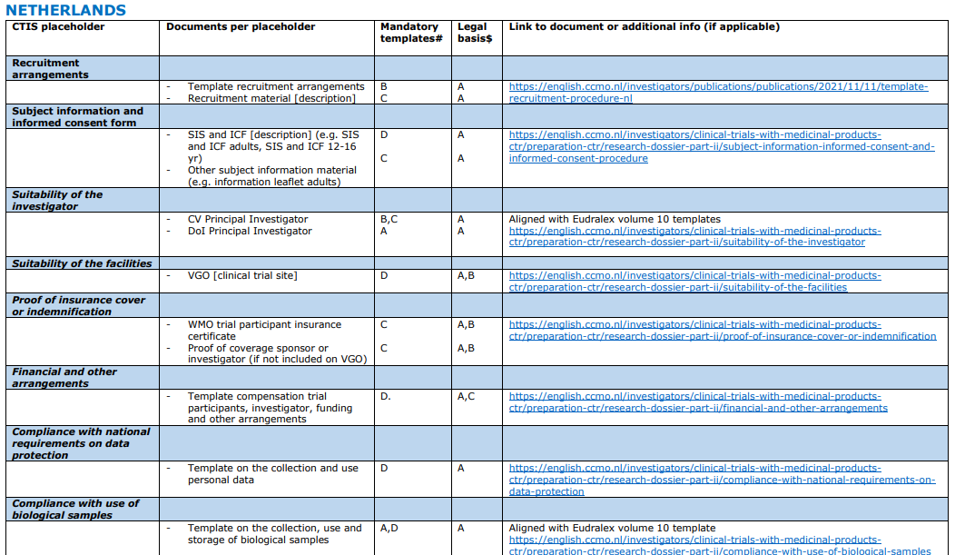
MedEthicsEU: European coordination of ECs
National representatives of Medical Research Ethics Committees (NL: Monique Al, co-chair)
Created in 2024, almost all MS participate
Cooperation between MS ECs, harmonisation of ethics review in Europe
Scope: CTR, MDR, IVDR
Monthly plenary meeting
For EC assessors: cooperation, alignment, knowledge sharing, discussion forum
For sponsors:
  overview of Part II requirements per MS (published →)
  harmonized K1 template Recruitment Arrangements (soon)
EU4Health Joint Action on CTR implementation contains a dedicated work package on EC review, led by NL CCMO and DK-Etik
medethicseu@ec.europa.eu
https://health.ec.europa.eu/medicinal-products/clinical-trials/medethicseu_en

Slide 20
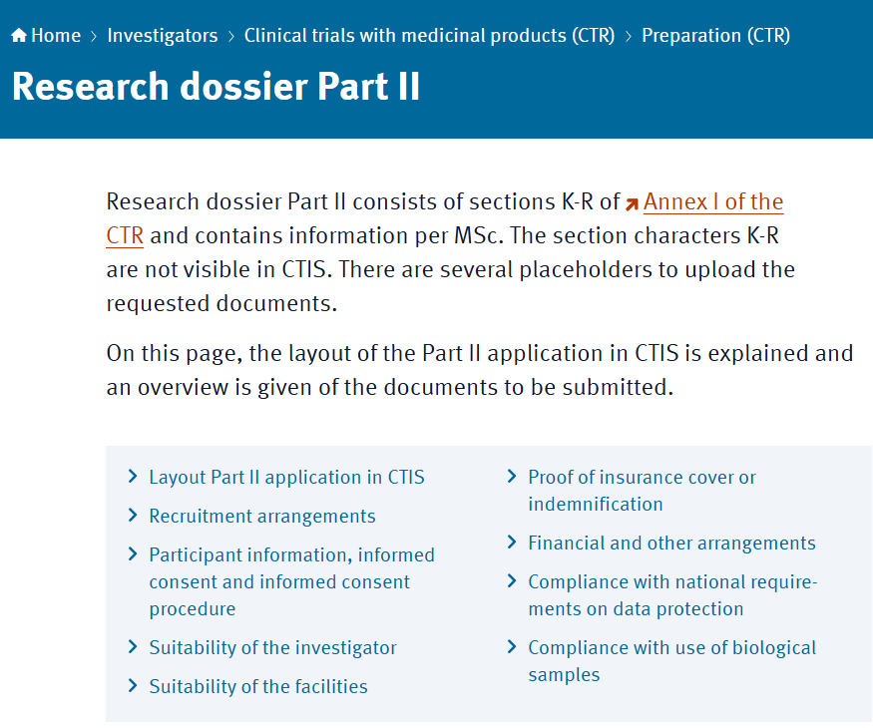
Part II forms – mandatory templates for NL
NL Part II templates: CCMO website
https://english.ccmo.nl/investigators/clinical-trials-with-medicinal-products-ctr/preparation-ctr/research-dossier-part-ii
K1 Recruitment Arrangements: NL template mandatory (much shorter than EU template), soon to be replaced by new MedEthicsEU template
P1 Financial and other arrangements: NL template mandatory (longer than EU template, a.o. because CTA not submitted for NL)
R1 Data protection: NL template mandatory (no EU template, MS policies vary widely)
S1 Biological samples: NL template identical to EU template (clarifications added)

Slide 21
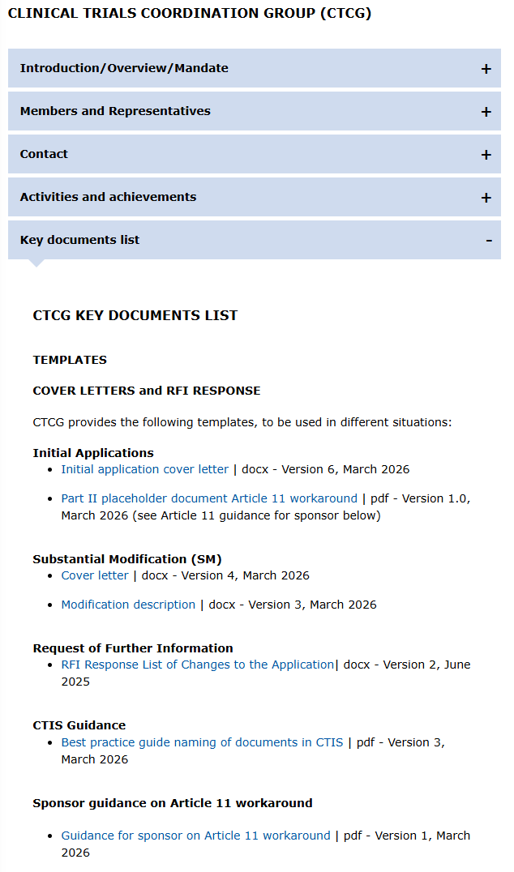
Upcoming new procedure: Article 11 workaround
27 April
Article 11: partial initial application, lacking Part II for some/all MSCs
Workaround: fill Part II with dummy trial site and placeholder docs
  technically a full application, all MSC can enter decision,
  allowing Part I SM
‘Partial MSCs’ authorise with condition,
requiring Part II SM with full Part II package
Implemented on 27 April 2026 – no transition/grace period!
CTCG website, Key Documents List
  guidance for sponsors
  placeholder PDF for Part II
  updated cover letter templates (soon)

Slide 22
Upcoming new procedure: patient-facing documents in Part II (1)
Patient-facing documents used to measure primary/secondary endpoints
Currently, EN + national languages all uploaded in Part I protocol section (D4)
→ very crowded section
From 27 April 2026: MS translations moved to Part II
EN version will stay in current location Part I, all versions in MS national languages should be submitted in Part II, R section (Compliance with data protection), document code R2
For mononational trials where only a non-English document is used, this is uploaded in Part I
Applies per 27 Apr to all new initial applications – not retrospectively for SM
If sponsors cannot comply by 27 Apr, add a justified request for exemption in the cover letter
Sponsors are encouraged to apply this ASAP, also allowed before 27 Apr

Slide 23
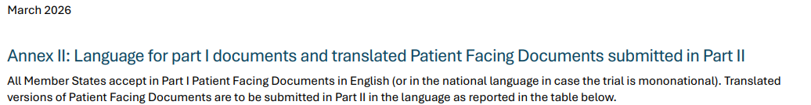
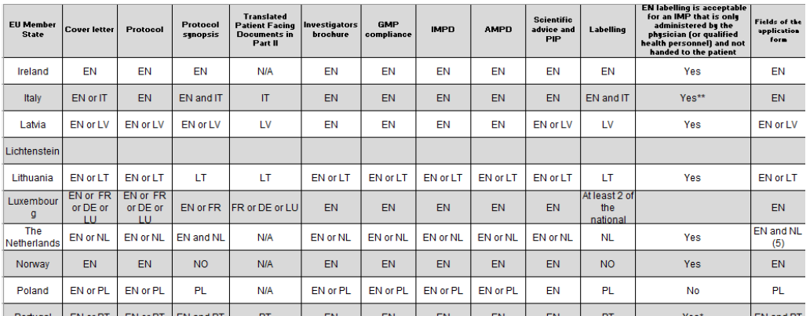
Upcoming new procedure: patient-facing documents in Part II (2)
CTR Q&A, Annex II shows MS language requirements
– these have not changed, only the location has
For example:
Italy requires English AND Italian versions
→ EN version in Part I, IT version in Part II
NL requires English OR Dutch versions
→ EN version in Part I, nothing in Part II
→ CTCG/MedEthicsEU webinar on Art.11 workaround and patient-facing documents
Tomorrow 15 Apr, 14.00-15.30 – no registration required
Teams link in CCMO LinkedIn post, or CTCG website (News and events)

Slide 24
Upcoming releases – CTIS (1)
General note: planning of CTIS updates very uncertain due to impact of BTA
Modernisation roadmap is currently being revised
Email notification (soon)
Receive an email for each message as seen in CTIS Notices & Alerts, opt-in, not selectively
New safety module (Q2 2026.. or Q3?)
Annual Safety Report (ASR) submission and assessment
For sponsors: notifications on all relevant events, email notification possible
For MS: selection of safety-assessing MS (SaMS), easier to find relevant trials

Slide 25
Upcoming releases – CTIS (2)
Document management – selectivity and reliability of ‘All Documents’ and multidownload
For sponsors: selectively seeing what was authorised in this application (incl export of list, download of documents)
For MS: selectively seeing and downloading documents submitted in a new SM or in any RFI Response
Status: requirements scoped, awaiting technical preparation
Hopefully soon: document version + date not pre-filled (v1, today) by CTIS anymore when uploading.
→ fields are blank and mandatory → sponsor forced to fill in manually → fewer validation RFIs required
Already scoped, also part of BTA – unsure whether released with BTA or before
Parallel submission of SM depending on scope
RMS selection: simpler and faster, MS work-sharing implemented

Slide 26
Informatiebronnen

Slide 27


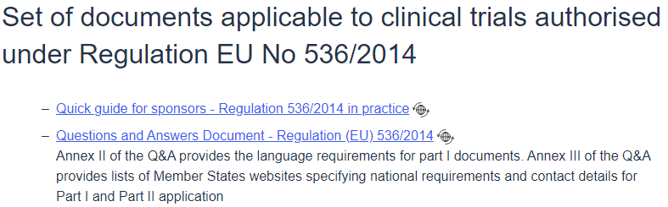

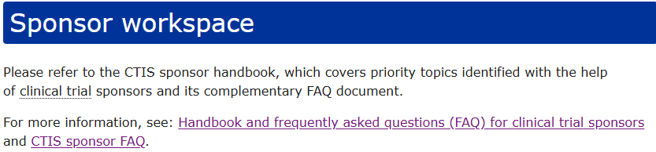
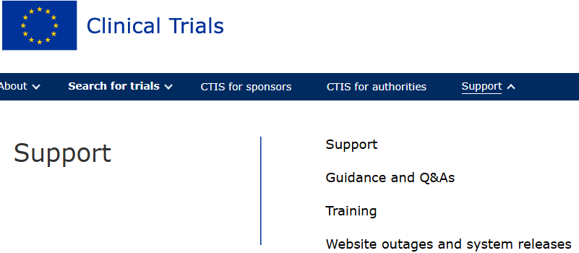
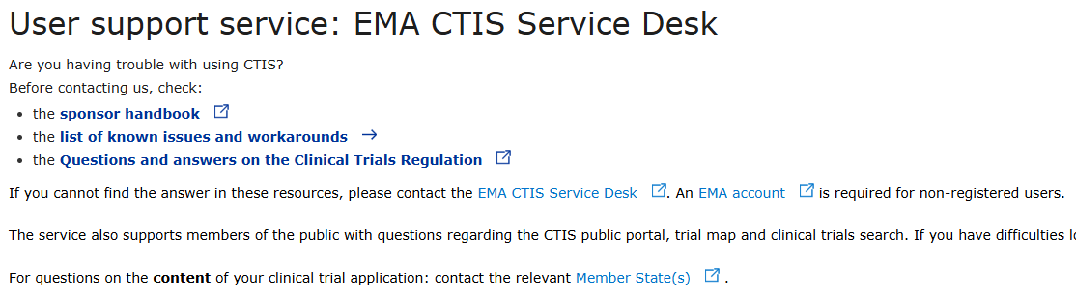
Informatiebronnen – EU
Europese Commissie (Eudralex volume 10, health.ec.europa.eu)
Quick guide for sponsors (currently not up to date)
CTR Q&A, met bijlages:
Annex I – is mijn studie een CTR-studie?
Annex II – document-taaleisen per lidstaat voor Part I
Annex II – contactadres lidstaten voor vragen over indieningen
Annex IV – voorbeelden van wijzigingen: substantieel, 81.9NSM, normale NSM
Annex V – changes to IMP source country
      Vele richtlijnen over specifieke onderwerpen
      bijv: nov2025 recommendations for using auxiliary products (AxMPs) in clinical trials
CTIS (EMA)
CTIS Sponsor handbook + FAQ (EMA website)
EMA servicedesk
CTIS-website (euclinicaltrials.eu) - Support
List of known issues
Release notes bij CTIS-updates
Planned downtime

Slide 28
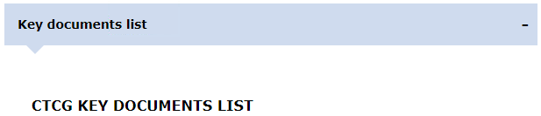
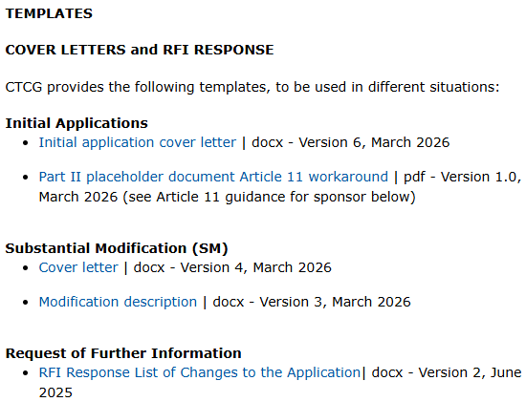
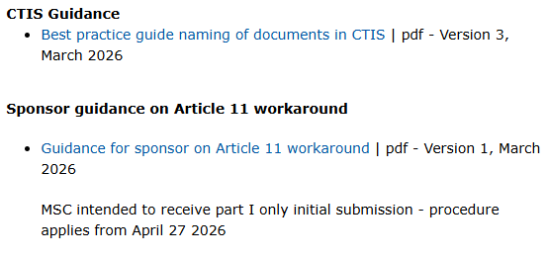
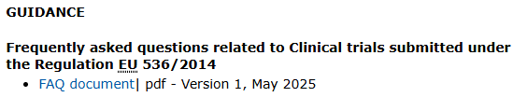
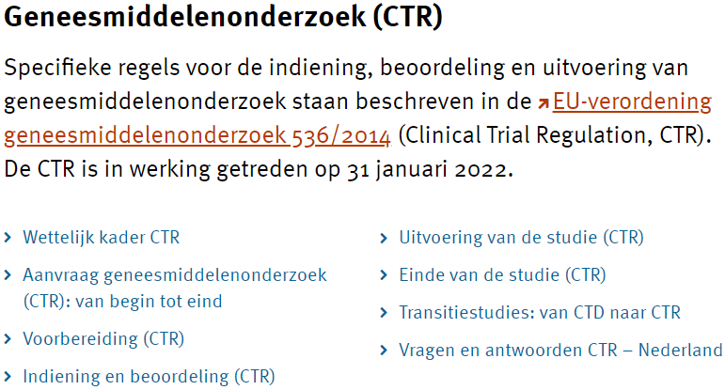
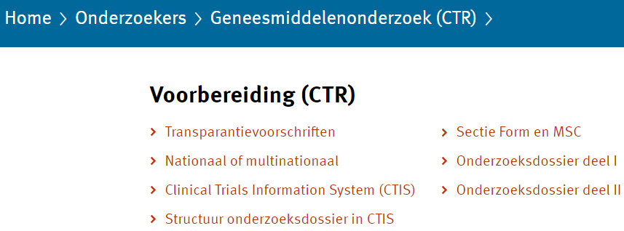
Informatiebronnen – lidstaten
CTCG-website: EU-brede vereisten
Templates voor cover letters (IN, SM, RFI)
Naamgeving documenten
Guidance bijzondere procedures
CTCG FAQ
https://www.hma.eu/about-hma/working-groups/clinical-trials-coordination-group.html
Part II en overige nationale vereisten
MedEthicsEU overzicht Part II per lidstaat (MedEthicsEU-website https://health.ec.europa.eu/medicinal-products/clinical-trials/medethicseu_en)
Websites van nationale autoriteiten
CCMO.nl
Documenten per sectie, verplichte templates
Instructies CTIS (uploaden, indienen, wijzigen)
Checklist voor validatie

Slide 29
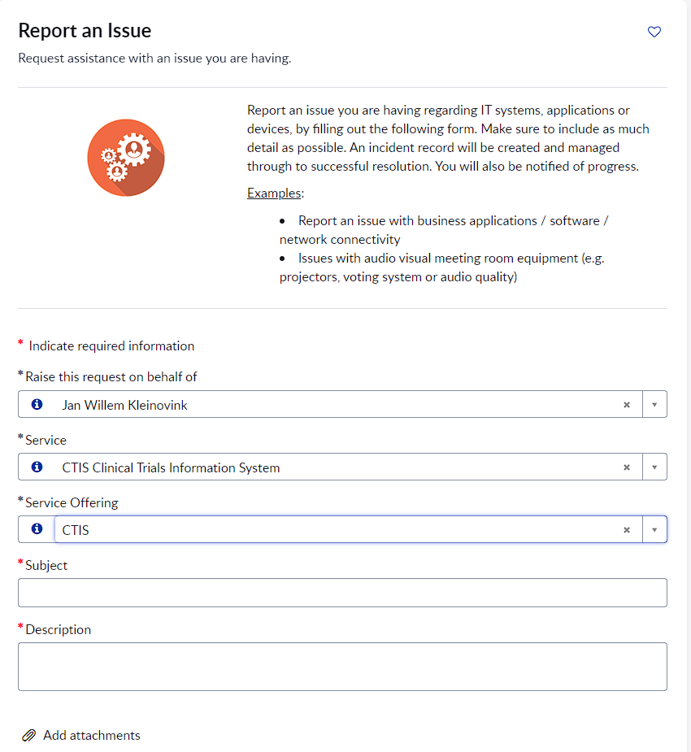
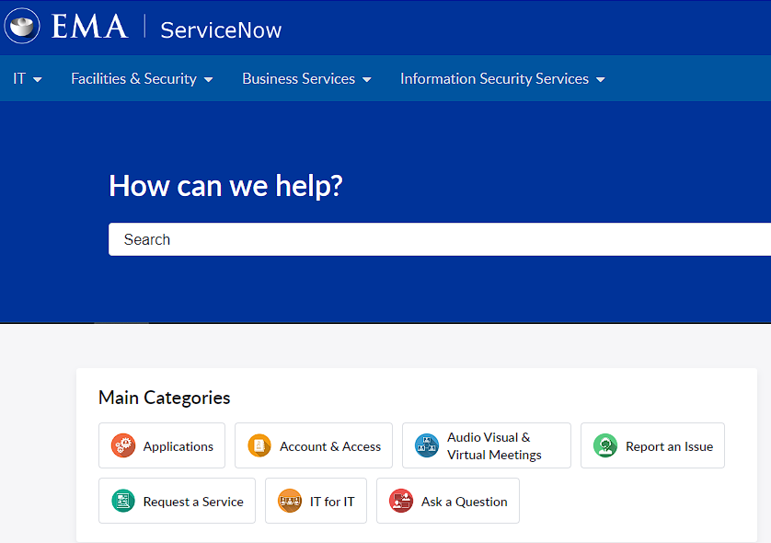

EMA service desk
Technische problemen in CTIS
Beschrijf duidelijk het probleem, noem het trialnummer en de precieze stap die niet lukt, benoem urgentie (due date) als die er is.
Screenshots!!
support.ema.europa.eu

Slide 30

CTR helpdesk CCMO
ctr@ccmo.nl
Do: send any questions or remarks about CTR, CTIS, applications and documents, technical issues, etc
You may, but don’t have to: announce multinational trial with NL as proposed RMS, announce any submission
Do not: ask when the RFI will be sent, ask whether Response X will be accepted
Self-help before asking for assistance:
CTR Q&A European Commission, and other guidances on Eudralex volume 10
CTIS sponsor handbook EMA (now including FAQ), CTIS list of known issues
CCMO website
CTCG website
MedEthicsEU website

Slide 31
Rondvraag
en discussie

Slide 32
Vragen en stellingen
Wat is er nodig om Nederland aantrekkelijk te houden/maken voor commercieel klinisch onderzoek?
En wat voor academisch (investigator-initiated) onderzoek?
Zien jullie de afgelopen 2 jaar trends in
  het aantal studies met conditionele goedkeuring, leidend tot vertraging studiestart?
  verschillen tussen METCs, en tussen lidstaten, in de beoordeling?
Bij vragen of problemen mbt CTR/CTIS weet ik waar ik moet zijn.
De lidstaten (bevoegde instanties) zijn goed bereikbaar voor vragen.

Slide 33




