Slide 1

Instructions
Office chaos
-
Mission:
Patient Safety
This game consists of 20 numbered cards. Don’t shuffle them, keep them in order. There are no rules, simply follow the instructions on the cards.
The cards tell a story with several puzzles. Solve them as quickly as you can, but be careful. Each mistake adds one or more penalty-minutes to your total time.
The team with the best time wins a small prize.
The next card is your Scorecard. Fill in your names and start time. Put the card aside and begin the game.
Have fun!
Scorecard
Scorecard
Team:
Team:
_______________________
_______________________
_______________________
_______________________
Start time (hh:mm):
Start time (hh:mm):
:
:
Finish time (hh:mm):
Finish time (hh:mm):
:
:
For mistakes, mark the indicated number of Xs here:
_________________________________________________
For mistakes, mark the indicated number of Xs here:
_________________________________________________

Slide 2


Slide 3



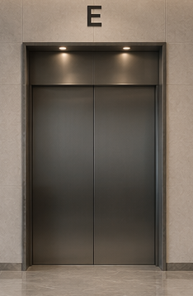
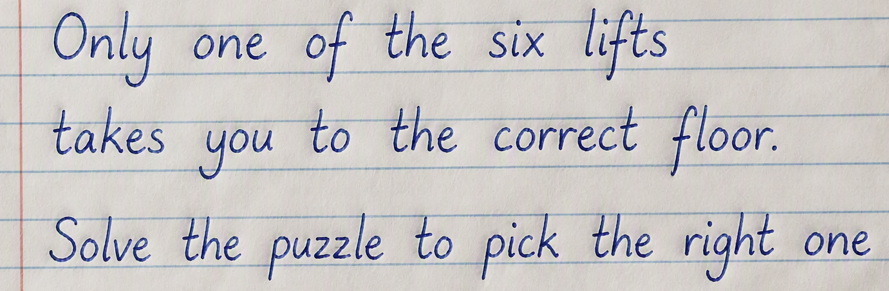
1
2
It is Monday morning. After a busy but fun weekend, you arrive at the office.
You look forward to starting the day with coffee with your colleagues.
You enter the office and walk to the lifts. You scan your lift pass, but an error code appears on the screen.
The lifts do not seem to be working properly!
Go to the next card
Go to the next card
3
4
You look around at the different lift doors. In the middle of lift E's door, you find a note
Use the puzzle pieces on the next three cards

Slide 5


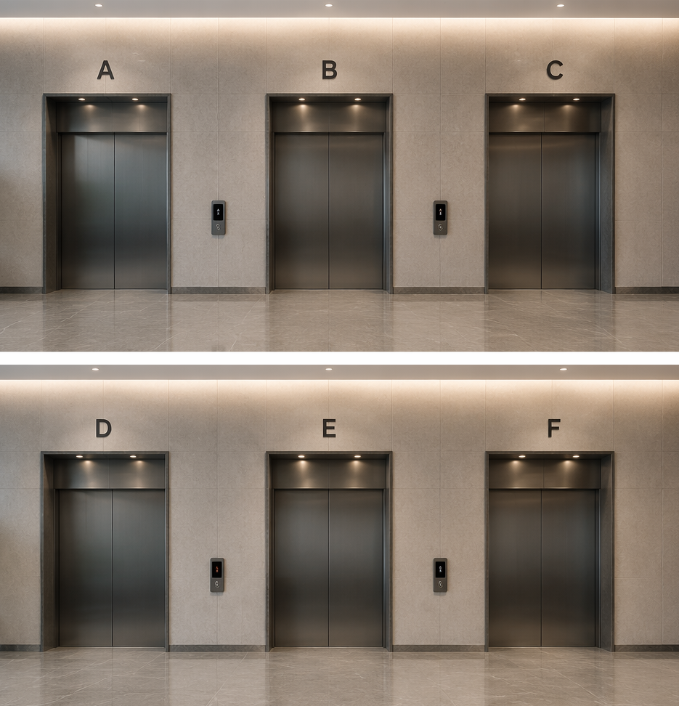
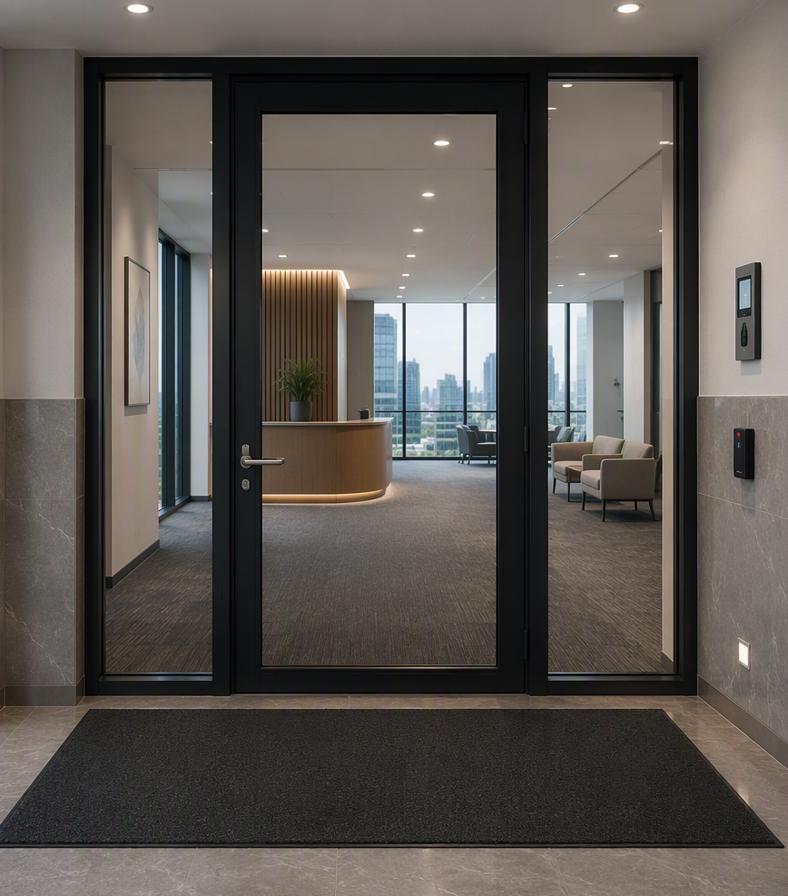
5
6
7
8
You have arrived on the correct floor. You see two notes on the door which you don’t quite understand.
You take them with you just in case, they may come in handy!
Which lift do you choose?
Turn this card over once you have chosen one
Turn the card over to see the notes. Save them for later

Slide 6
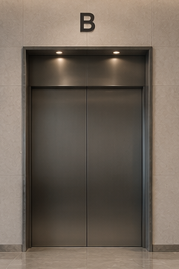

Notes
Answer
Correct number Right place
Incorrect number
Correct number Wrong place
Hopefully you chose lift B! Did you choose a different lift? Mark an X on your scorecard before continuing

Slide 7
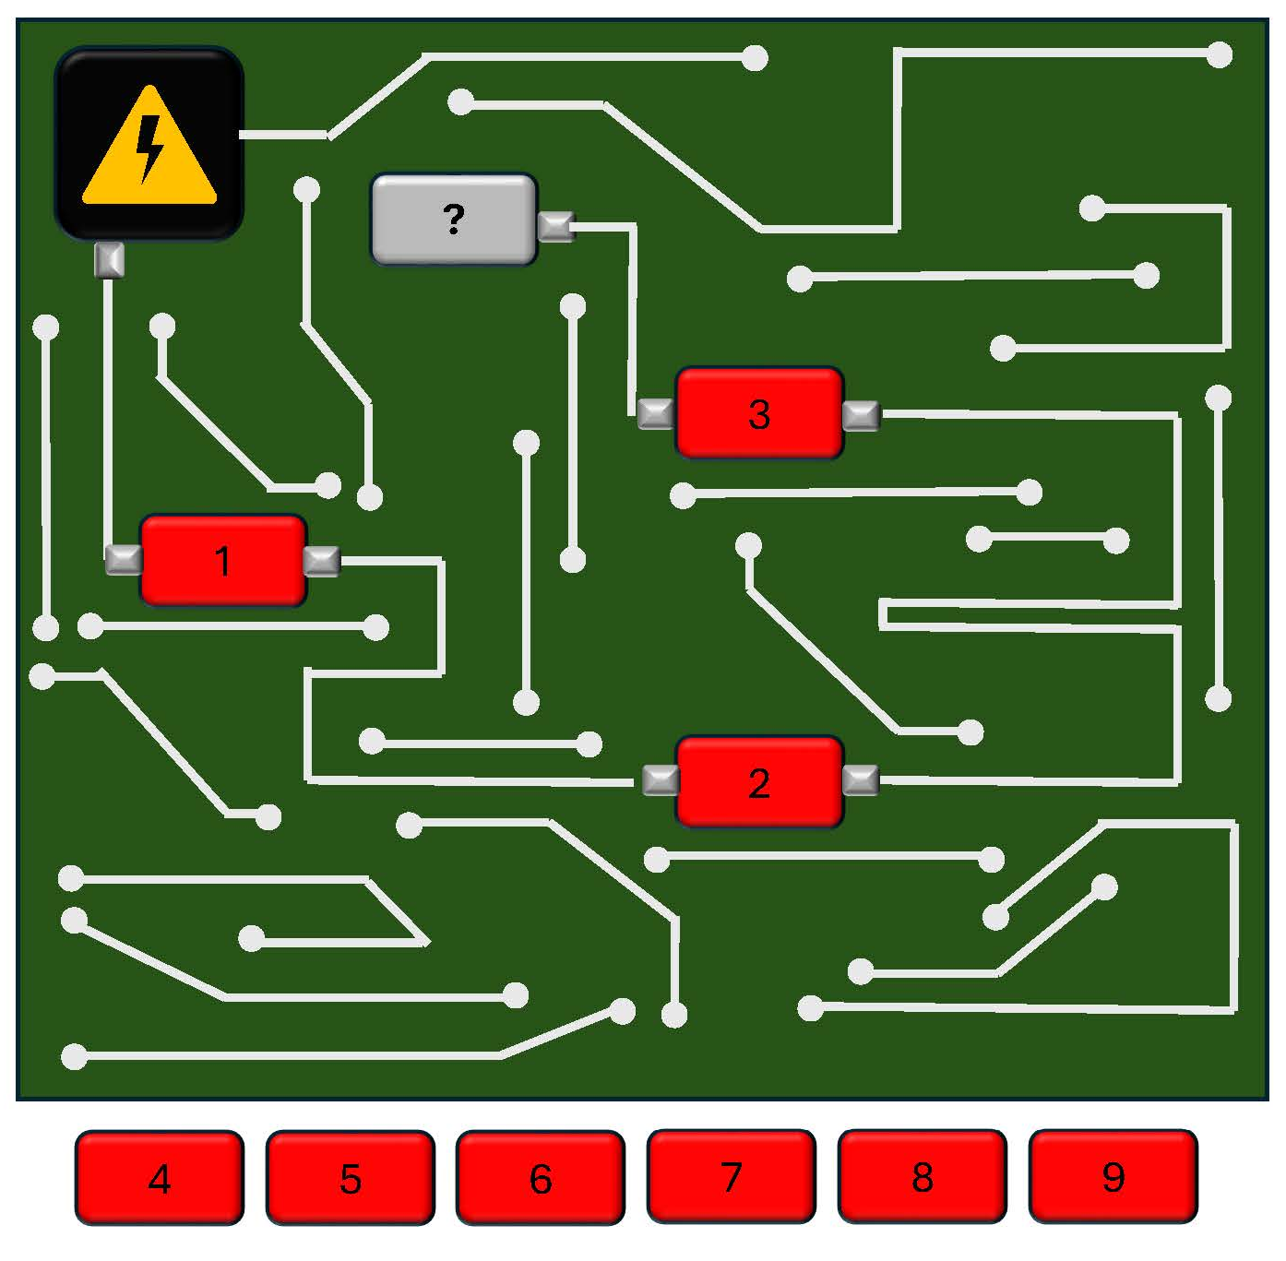
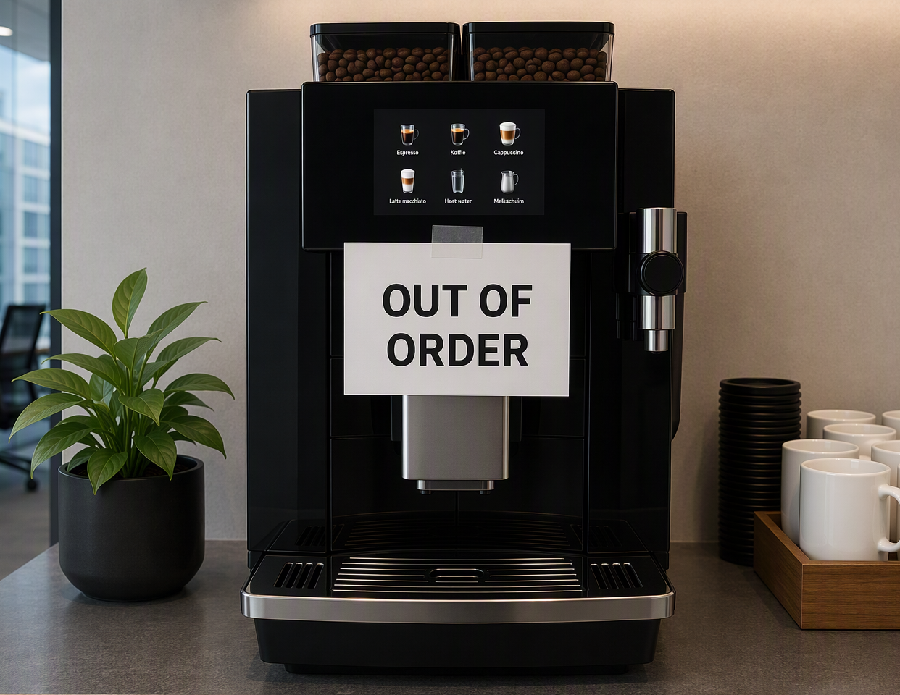

9
10
Once inside, you quickly put your bag on a desk and walk to the coffee machine.
But bad luck: it is out of order!
You open the coffee machine:
Which element should you place in the coffee machine’s circuit to power it?
Turn the card over once you have chosen an element
Go to the next card
11
12
Please help me, it seems like the Adverse Event (AE) system doesn’t work anymore!
I need urgent access because I received an important AE about a non-communicable disease!
Suddenly your colleague from Patient Safety comes running down the stairs. She seems panicked. You ask: What’s going on?
Go to the next card
Go to the next card

Slide 8
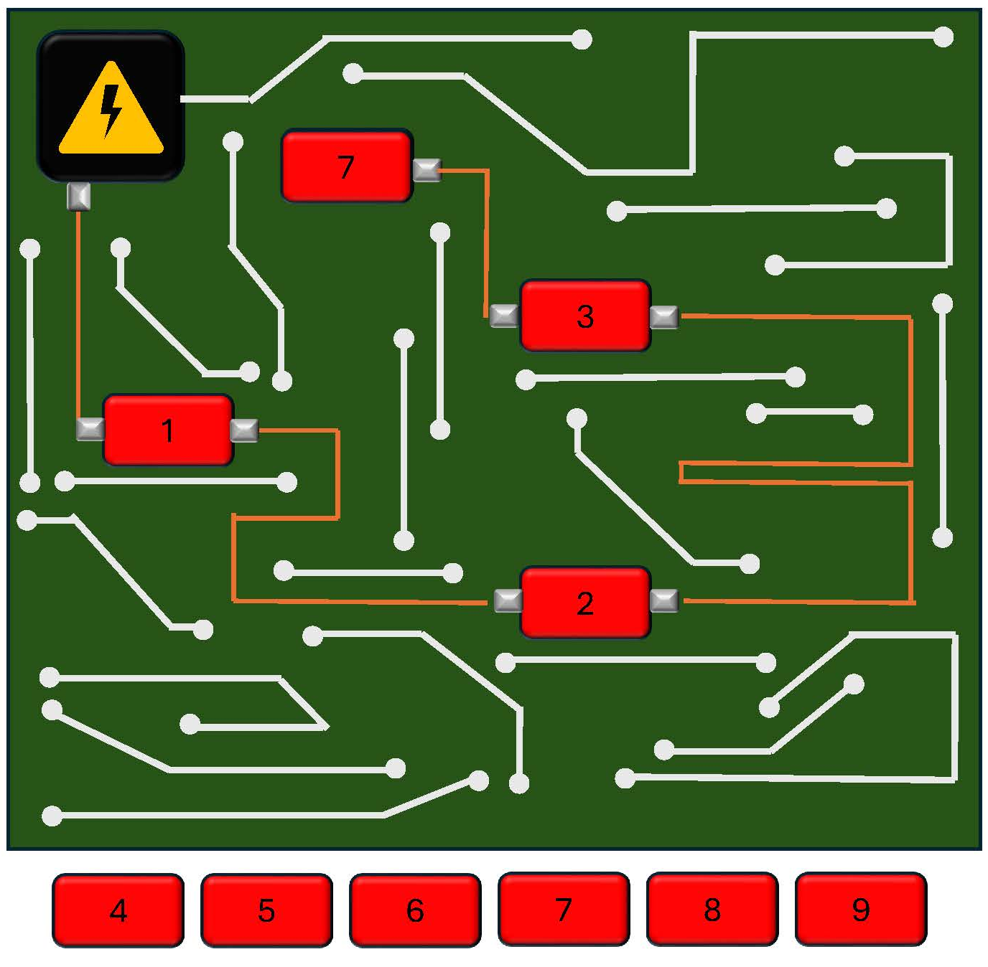
Answer
Hopefully you chose element ‘7’!
Did you choose another one? Mark an X on your scorecard before continuing

Slide 9
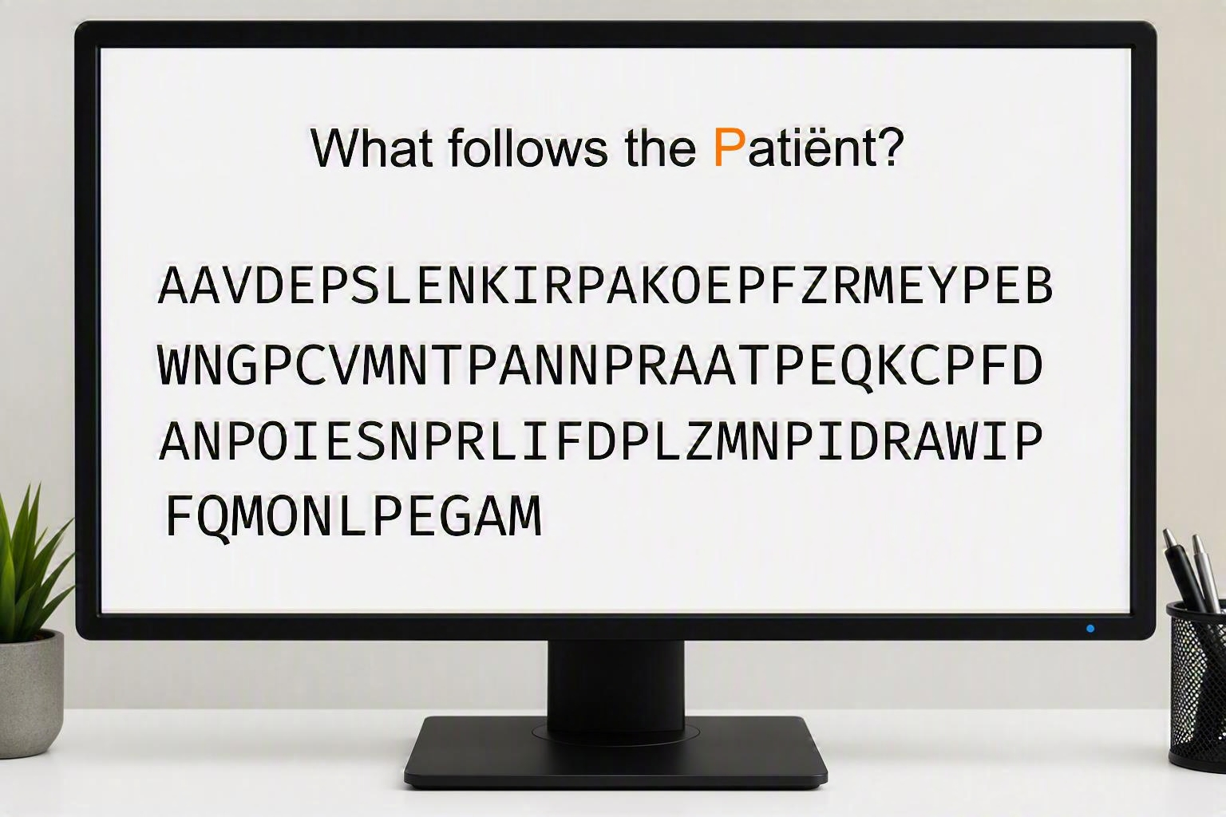
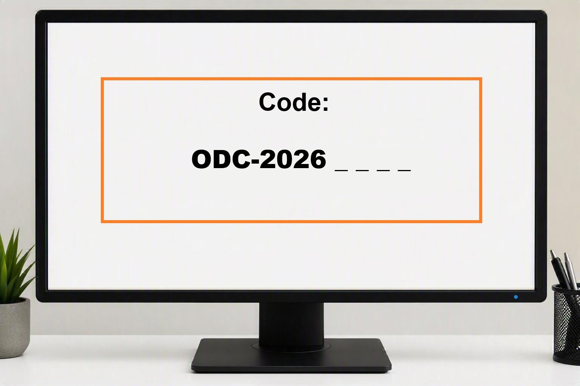
13
14
Immediately, a new challenge appears:
Your colleague must process an adverse event from an Organized Data Collection Program in time. The ODC-number is essential!
Together you walk to her computer and see the following screen:
What should you type into the system to get it working again? Turn the card over when you know the answer
You know the program started this year, so the code begins with ODC-2026. But what are the last four digits? Find the code with the puzzle on the next card
15
16
3
9
4
2
0
1
7
8
0
3
1
1
1
2
Because the system was down temporarily, there is a major risk that important data has been lost.
Perform a Quality Check on a previous report to check whether information is missing in the AE system.
6
9
0
1
1
3
2
7
0
1
3
?
?
?
?
1
2
1
What are the last four digits of the ODC-number? Turn the card over once you have deciphered the code
Compare the AE report and the entry in the AE system on the next two cards

Slide 10
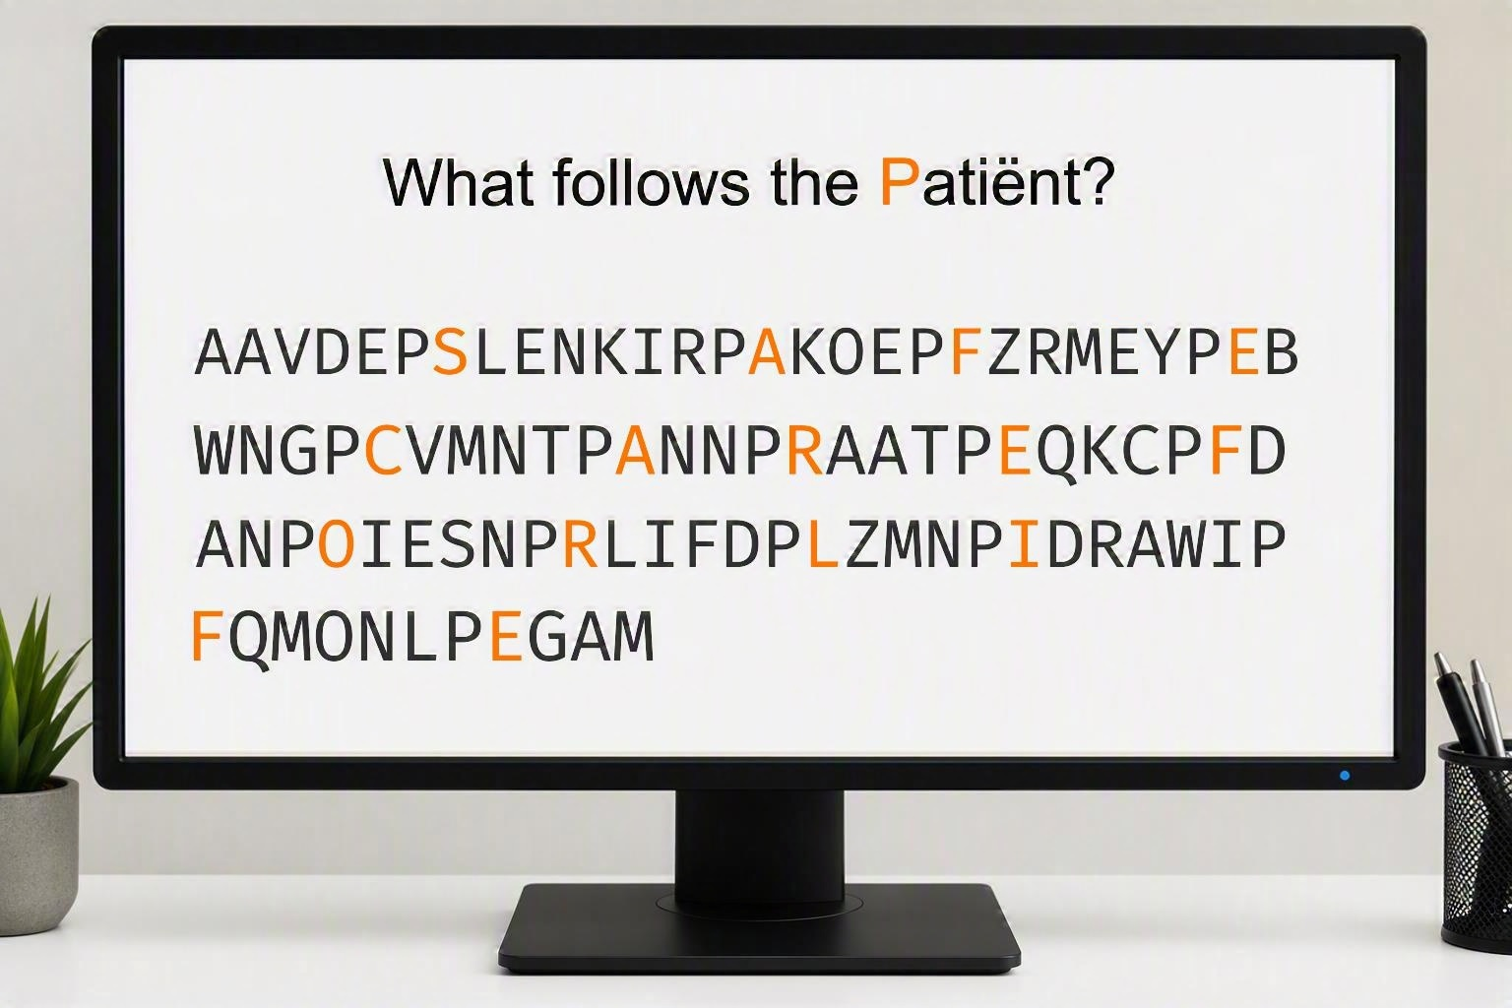
Answer
With the help of the hint you found earlier, you accessed the system with Safe care for life
If you answered anything other than ‘Safe care for life’, mark two Xs on your scorecard before continuing
Answer
With the help of the hint you found earlier, you found the ODC-number.
The report was processed on time!
3
9
4
2
0
1
7
8
0
3
1
6
9
0
1
1
1
2
1
3
2
7
0
1
3
1
0
7
9
1
2
1
If you answered anything other than ‘1709’, mark three Xs on your scorecard before continuing

Slide 11
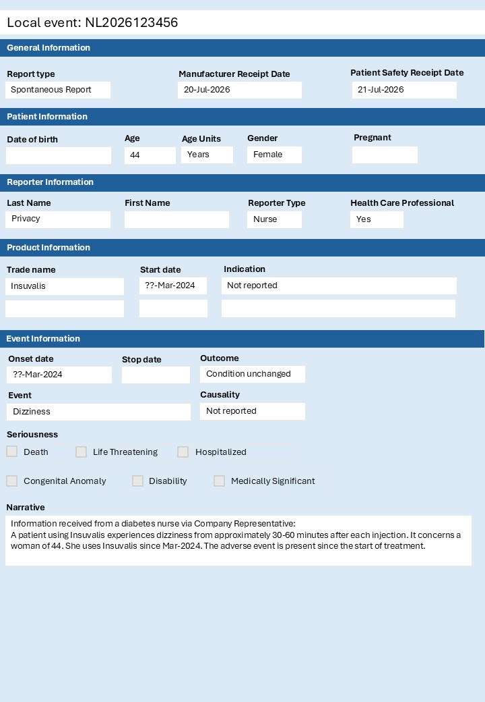
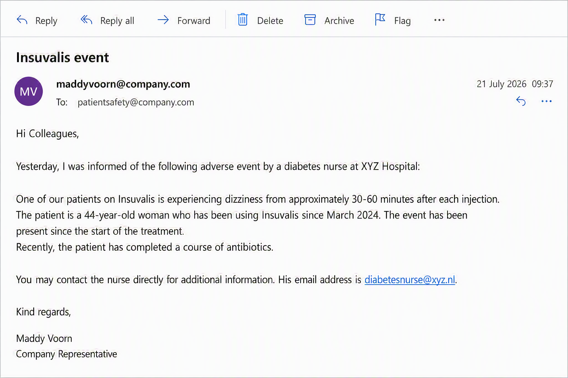


17
18
AE report
AE system
19
20
CASE CLOSED!
Thank you, because of your contribution to patient safety, we can make a difference for all patients!
QC outcome
No findings
Finding(s):
Is there information missing in the AE system? Turn the card over once you have found the answer
Fill in the time on your scorecard and give it to your Patient Safety colleagues. They will announce the winner soon!

Slide 12
Answer
You completed a successful Quality Check and corrected the error!
QC outcome
No findings
Finding(s): Antibiotics course missing
If you answered anything other than the missing antibiotics course, mark an X on your scorecard before continuing

Slide 13
Scorecard
Scorecard
Team:
Team:
_______________________
_______________________
_______________________
_______________________
Start time (hh:mm):
Start time (hh:mm):
:
:
Finish time (hh:mm):
Finish time (hh:mm):
:
:
For mistakes, mark the indicated number of Xs here:
_________________________________________________
For mistakes, mark the indicated number of Xs here:
_________________________________________________
Scorecard
Scorecard
Team:
Team:
_______________________
_______________________
_______________________
_______________________
Start time (hh:mm):
Start time (hh:mm):
:
:
Finish time (hh:mm):
Finish time (hh:mm):
:
:
For mistakes, mark the indicated number of Xs here:
_________________________________________________
For mistakes, mark the indicated number of Xs here:
_________________________________________________

Slide 15
Scorecard
Scorecard
Team:
Team:
_______________________
_______________________
_______________________
_______________________
Start time (hh:mm):
Start time (hh:mm):
:
:
Finish time (hh:mm):
Finish time (hh:mm):
:
:
For mistakes, mark the indicated number of Xs here:
_________________________________________________
For mistakes, mark the indicated number of Xs here:
_________________________________________________
Scorecard
Scorecard
Team:
Team:
_______________________
_______________________
_______________________
_______________________
Start time (hh:mm):
Start time (hh:mm):
:
:
Finish time (hh:mm):
Finish time (hh:mm):
:
:
For mistakes, mark the indicated number of Xs here:
_________________________________________________
For mistakes, mark the indicated number of Xs here:
_________________________________________________

